Slide 1

Cse-326 PROJECT TITLE: RESTAURANT
SUBMITTED BY:
HIMANSHU RAJ B37
SACHIN CHAURASIA B28
ROHIT MISHRA B30
SECTION :
K1629.
SUBMITTED TO :
USHA MAM.

Slide 2
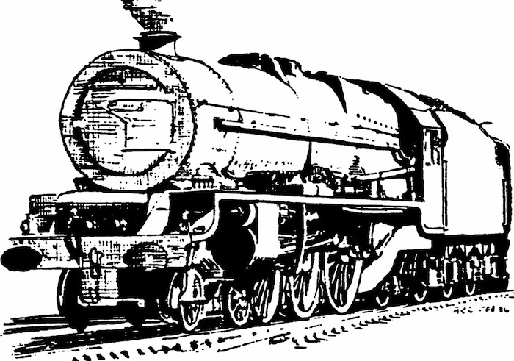
EXECUTTION INSTRUCTIONS :
IMPORTANT NOTE: DONOT DELETE OR REMOVE ANY IMAGE IN THIS FILE.
OTHERWISE PROJECT WILL NOT WORK PROPERLY.
TO START PROJECT : OPEN p1.html first and then make reservations.
PAGE IDENTIFICATION:
p1.html (LOGIN PAGE).
p2.html (HOME PAGE).
p3.html (TRAIN SCEHEDULE TABLE PAGE).
p4.html (CLASS AVALABILITY TABLES(3) PAGE).
p5.html (BOOKING TABLE PAGE).
p6.html ( CANCELLATION FORM PAGE).
p7.html (BILLING FORM PAGE).
ipic.html (DEFAULT IFRAME PAGE).
book.html (BOOKED STATUS PAGE).
cancelpic.html (CANCELLED STATUS PAGE).

Slide 3
VARIOUS WEB PAGES ARE: LOGIN PAGE . HOME PAGE . TRAIN SCHEDULES . BOOKING and BILLING. CANCELLATION.
INTRODUCTION ABOUT PROJECT.
This project is about the designing of a Railway reservation system which enables the user to know the schedule time of train and do reservation , billing and so many things. There are three web pages which are linking to each other by using hypertexts (enable the user to move from one web page to another) .
The purpose of the browser is to read HTML documents and compose them into web pages.

Slide 4
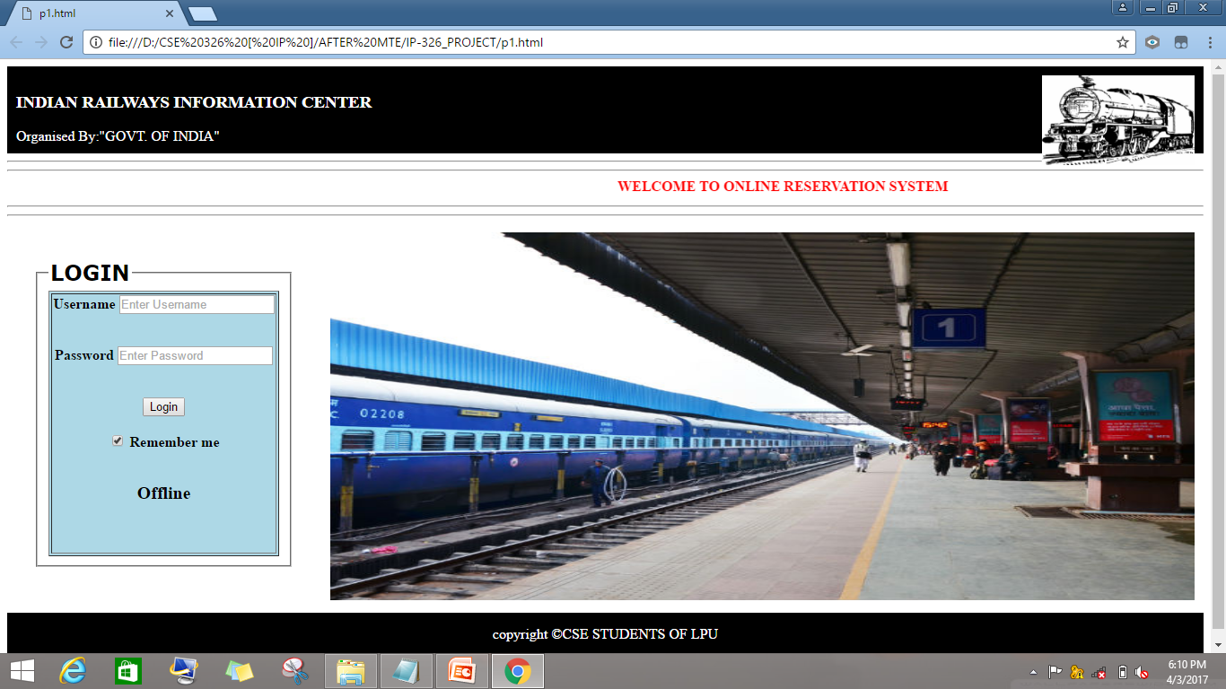
LOGIN PAGE:
This WEB PAGE perform the process of LOGGING IN.
It contains a FORM TABLE which is a combination of USER’S IDENTIFICATION and PASSWORD.
After entering required details, submission can be done by pressing SUBMIT button.(or by OFFLINE button).
OFFLINE button is a hypertext which enables the user to enter into HOME PAGE of railway reservation system and make reservations.

Slide 5
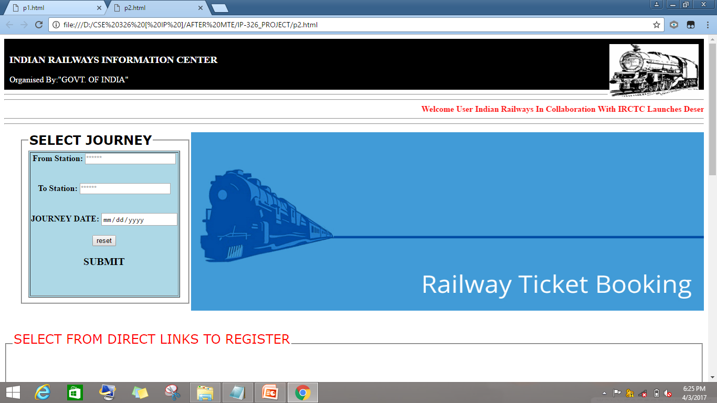
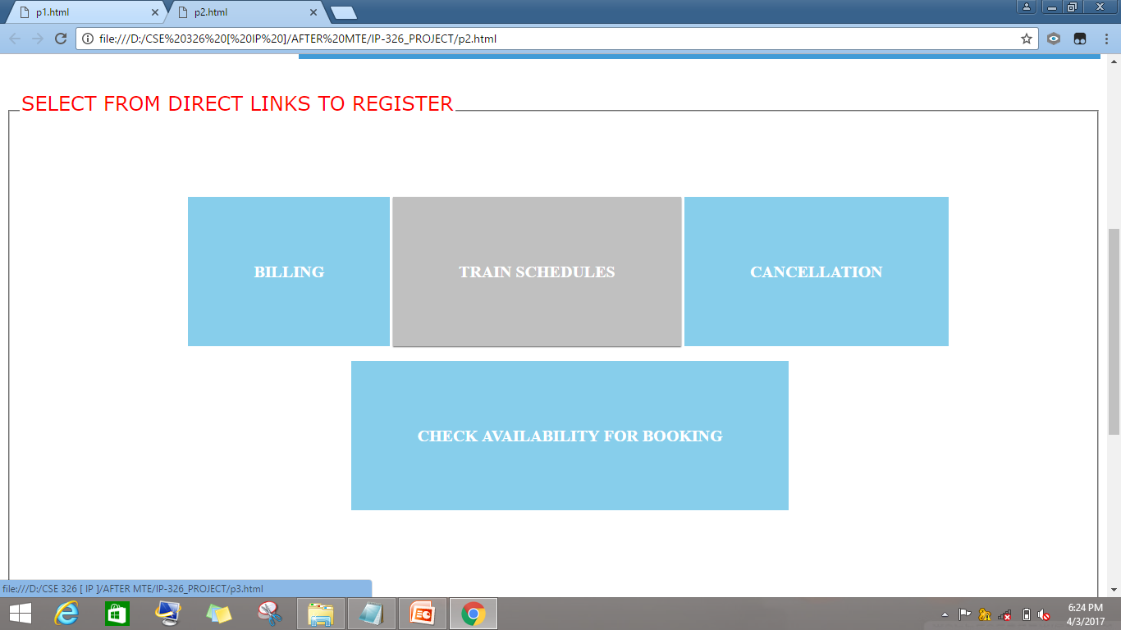
HOME PAGE:
This webpage contains a FORM TABLE and various hypertexts:
FORM TABLE: Here user fill their journey details and make reservation by pressing SUBMIT button(which interlinked to another webpage).
HYPERTEXTS: These texts are interlinked to various web pages and to register user can also choose these direct links.

Slide 6
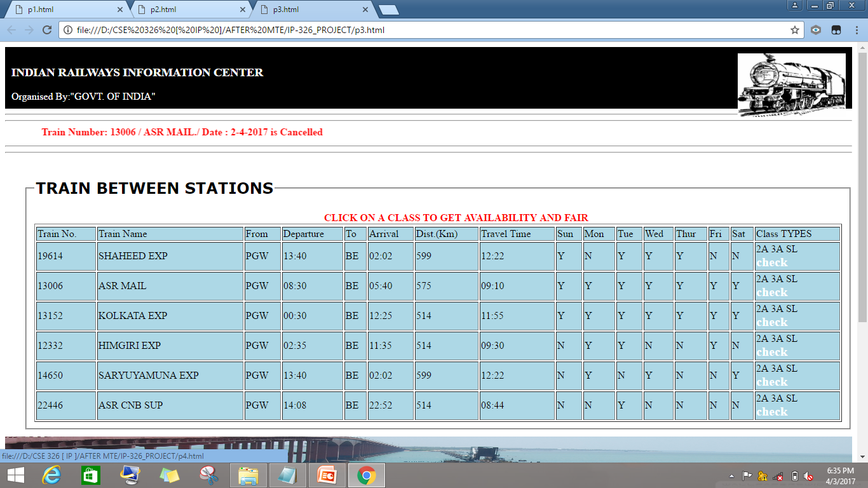
TRAIN SCHEDULES:
This webpage contains a table which shows train details:
The table shows trains between station and their departure & arrival timing.
The table also allow the user to check availability of class type (SL,2AC,3AC) this can be done by using CHECK button which placed in column namely “Class types”

Slide 7
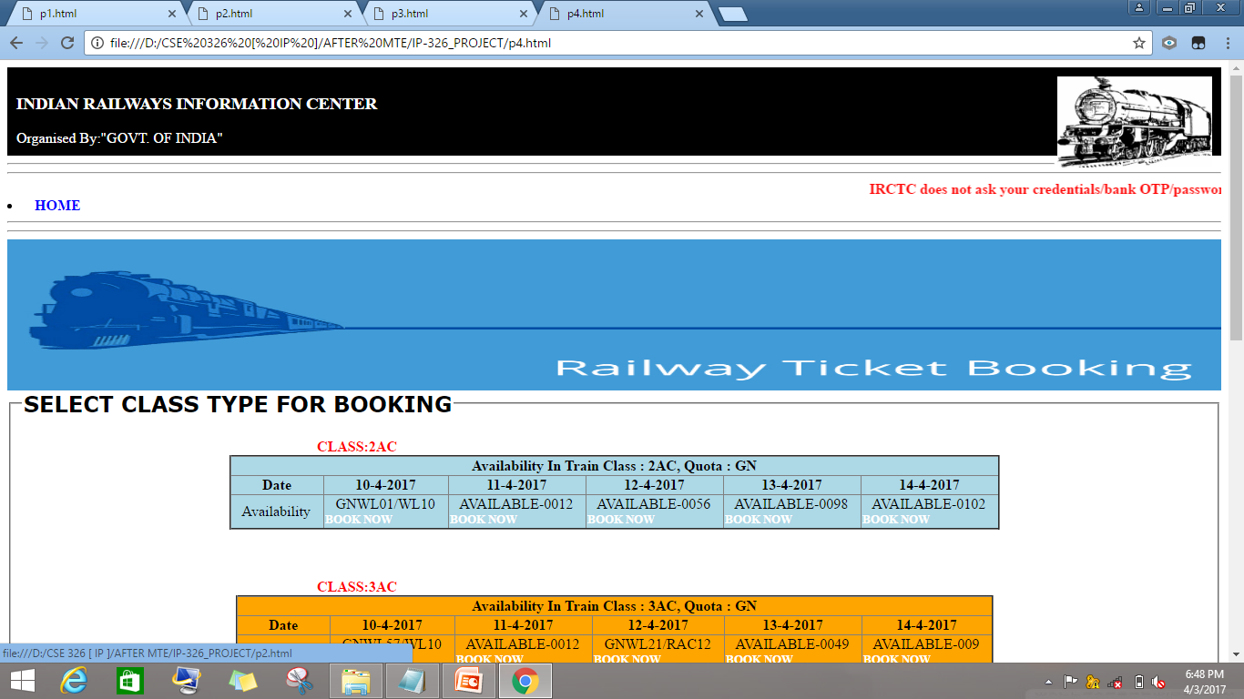
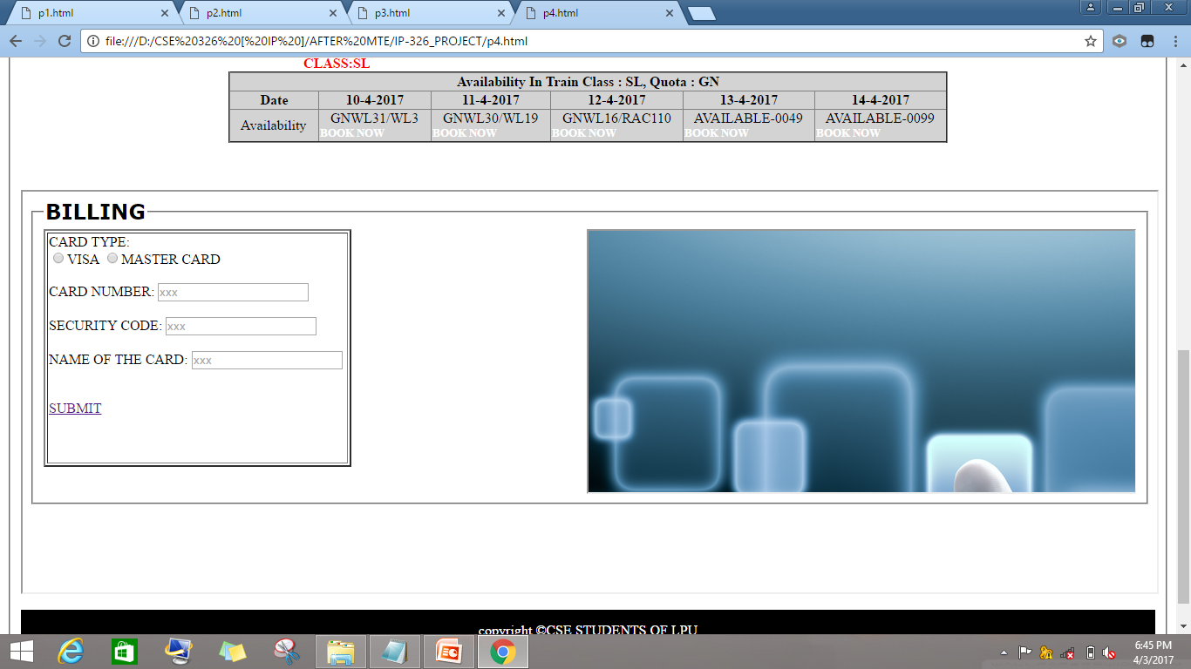
BOOKING & BILLING
This web have 3-tables and a iframe at the bottom.
TABLES :
<a>.First table, shows the availability of trains in 2AC class.
<b>.Second table, shows the availability of trains in 2AC class.
<c>.Third table, shows the availability of trains in 2AC class.
Each table have hypertexts in it namely as “BOOK NOW”.(By pressing it, Passenger details form table can be open in IFRAME which is at the bottom of the webpage .
After filling and then submitting passenger details ,BILLING table will be open in IFRAME .User choose a card type and after entering details submit it, Webpage shows:
TICKET STATUS:”BOOKED”

Slide 8
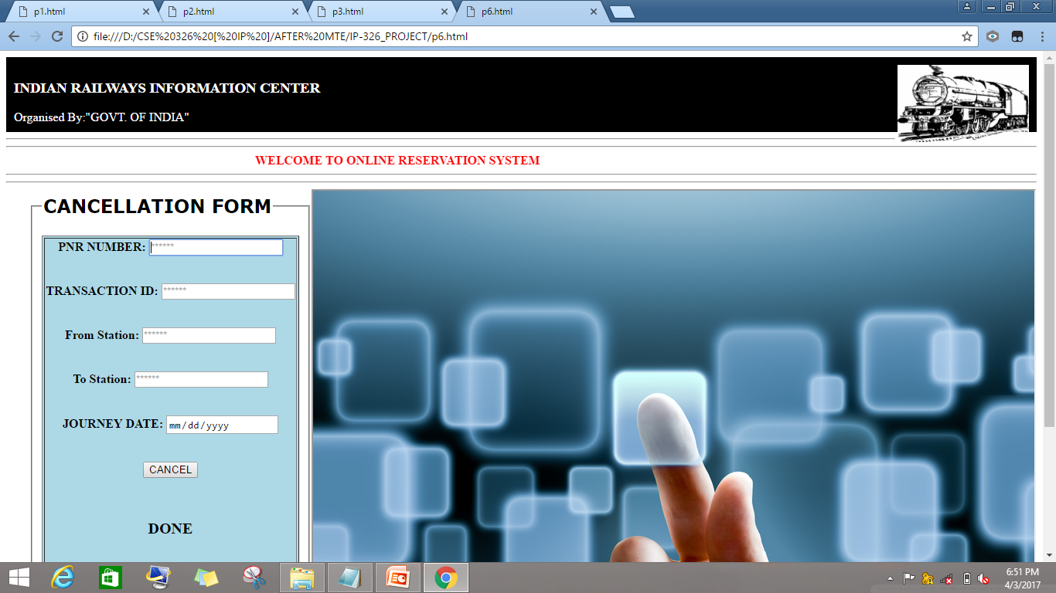
CANCELLATION
THERE IS A HYPER-LINK ON HOME PAGE WHICH ALLOWS THE USER TO PERFORM CANCELLATION.
BY pressing this hyper-link ,a cancellation form table appears and it tells the user to enter the desired details of ticket and after submmiting it.
Webpage shows
TICKET STATUS:CANCELLED

